Slide 1
Federal Programs
2019-2020

Slide 2
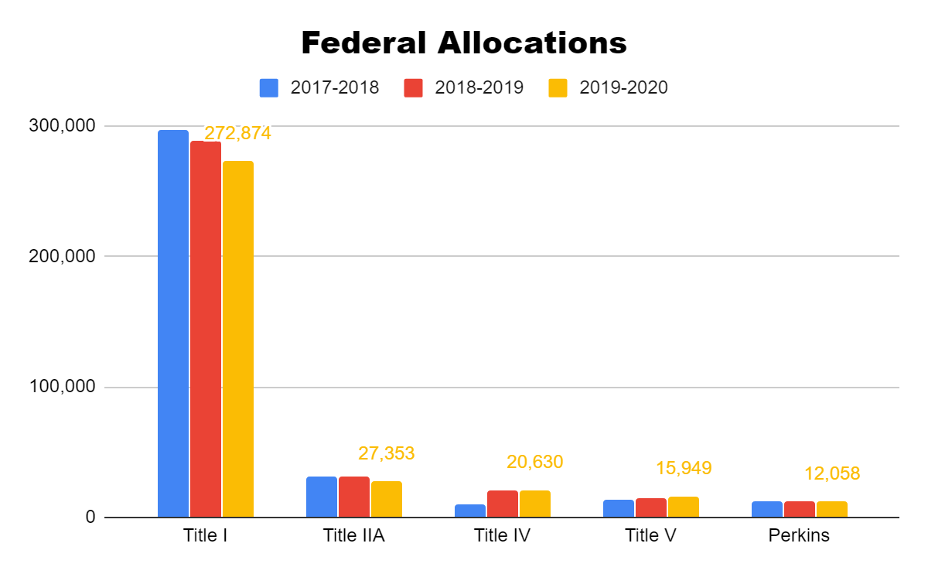

Slide 3
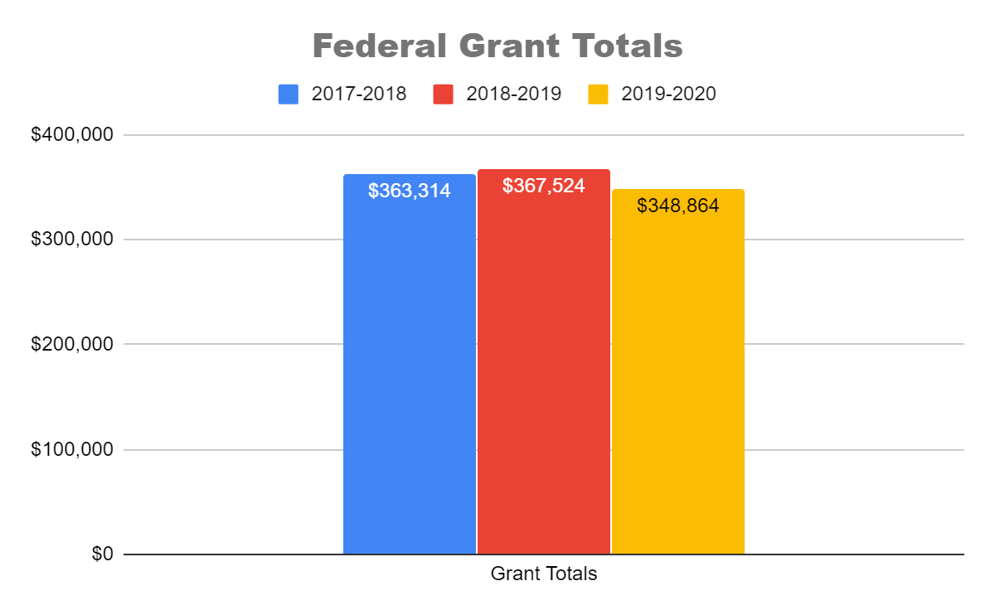

Slide 4
Parents’ Rights Regarding Federal Programs
HAVE A RIGHT TO ASK FOR A MEETING TO DISCUSS AND FORMULATE SUGGESTIONS AND TO PARTICIPATE IN DECISIONS ABOUT THE EDUCATION OF THEIR CHILDREN

Slide 5
PARENTS’ RIGHTS CONTINUED:
DISABLED PARENTS – HAVE A RIGHT TO ASK FOR AUXILIARY AIDS AND SERVICES TO AFFORD HAVE AN EQUAL OPPORTUNITY TO PARTICIPATE IN AND ENJOY THE BENEFITS OF TITLE I, PART A PROGRAMS. EXAMPLE: AN INTERPRETER

Slide 6
Parents’ Rights Continued:
PARENTS’ RIGHT TO KNOW
THE QUALIFICATIONS OF THEIR CHILD’S TEACHER AND THE PARAPROFESSIONAL WORKING WITH THE CHILD.
IF THEIR CHILD HAS BEEN INSTRUCTED BY A NON-HIGHLY QUALIFIED PERSON FOR 4 CONSECUTIVE WEEKS.
WRITTEN STATE COMPLAINT PROCEDURE

Slide 7
Food Service Rights
To file a program complaint of discrimination, complete the USDA Program Discrimination Complaint Form, (AD-3027) found online at: http://www.ascr.usda.gov/complaint_filing_cust.html, and at any USDA office, or write a letter addressed to USDA and provide in the letter all of the information requested in the form. To request a copy of the complaint form, call (866) 632-9992. Submit your completed form or letter to USDA by: (1) mail: U.S. Department of Agriculture Office of the Assistant Secretary for Civil Rights 1400 Independence Avenue, SW Washington, D.C. 20250-9410;
(2) fax: 202-690-7442; or
(3) email: program.intake@usda.gov This institution is an equal opportunity provider.

Slide 8
Children’s Internet Protection Act (CIPA)
Schools and libraries subject to CIPA are required to adopt and implement an Internet safety policy addressing:
Access by minors to inappropriate matter on the Internet;
The safety and security of minors when using electronic mail, chat rooms and other forms of direct electronic communications;
Unauthorized access, including so-called “hacking,” and other unlawful activities by minors online;
Unauthorized disclosure, use, and dissemination of personal information regarding minors; and
Measures restricting minors' access to materials harmful to them.

Slide 9
Right to File a Complaint with the FCC
Online at https://consumercomplaints.fcc.gov
By phone: 1-888-CALL-FCC (1-888-225-5322); TTY: 1-888-TELL-FCC (1-888-835-5322); ASL: 1-844-432-2275
By mail (please include your name, address, contact information and as much detail about your complaint as possible):
Federal Communications Commission
Consumer and Governmental Affairs Bureau
Consumer Inquiries and Complaints Division
445 12th Street, S.W.
Washington, DC 20554

Slide 10
QUESTIONS CONCERNING FEDERAL PROGRAMS
What is a Title I Schoolwide Program?
What is the purpose of the Parent Compact?
How can I find the Parental Involvement Plans for my school?
https://salemschools.net
How can I provide feedback to the school?
What if I have concerns about an at-risk child?
Serving on a committee
David.turnbough@salemschools.net

Slide 11
THank YOu!!!

